Slide 1

Auto-Waiting in Playwright
Playwright's powerful auto-waiting feature simplifies test automation by automatically waiting for the right conditions before performing actions.

Slide 2
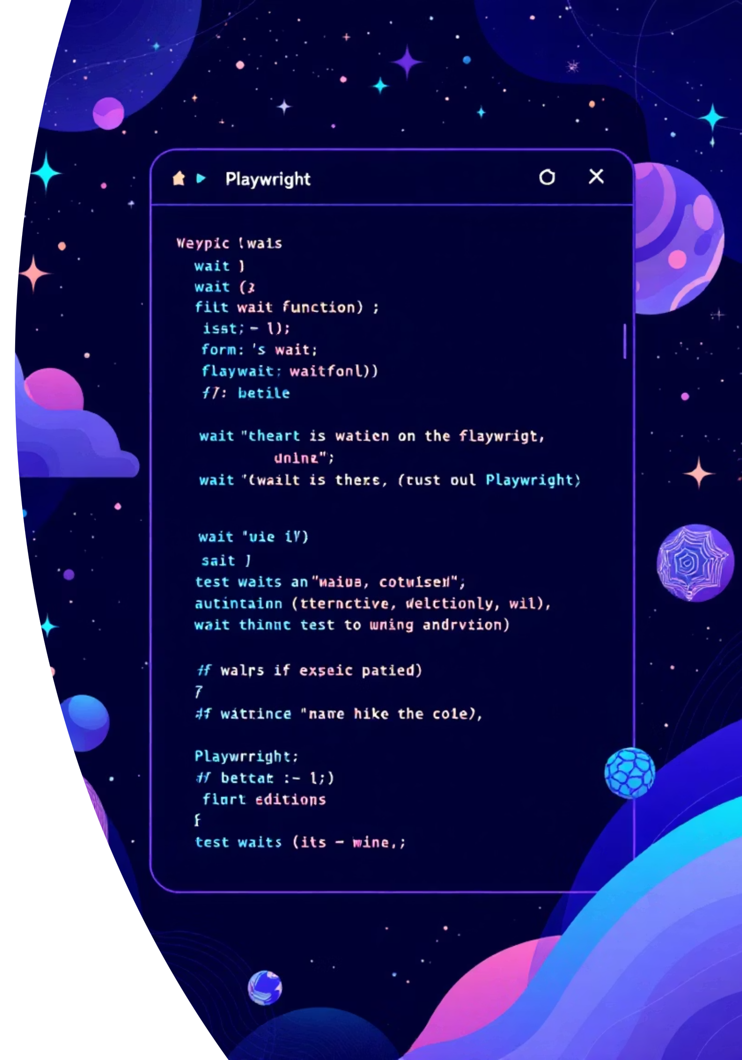
What is Auto-Waiting?
Automatic Conditions
Playwright waits for necessary conditions before executing actions like click(), fill(), type().
No Manual Waits
Removes need for sleep() or waitForTimeout() in most cases.

Slide 3

Actionable Checks
Before clicking a button, Playwright automatically waits until:
01
02
Attached to DOM
Visible
Element exists in the document structure
Element is displayed on the page
03
04
Enabled
Not Covered
Element can receive user interactions
No other element blocks the target

Slide 4

Forcing Actions
Some actions support force option that disables non-essential actionability checks:
await page.locator('button#submit') .click({force:true});
The force: true method skips checking if the target element actually receives click events.

Slide 5



Benefits of Auto-Waiting
Reduces Flaky Tests
More Stable & Reliable
Better Readability
Eliminates timing issues that cause unreliable test results.
Tests run consistently across different environments and conditions.
Cleaner, more maintainable test code without manual wait logic.

Slide 6





Timeout Configuration
Test Timeout
Default: 30,000ms (30 seconds)
How long a single test is allowed to run
Expect Timeout
Default: 5,000ms (5 seconds)
How long Playwright waits for assertions

Slide 7



Setting Timeouts
Global Config
export default defineConfig({ timeout: 60000});
Specific Test
test.setTimeout(60000);
Triple Timeout
test.slow(); // 3x default

Slide 8
Playwright Assertions
Auto-Retrying Assertions
Non-Retrying Assertions
Used on locators or pages
Used on primitive values
Asynchronous (use await)
Synchronous (no await)
Retry until condition passes
Execute immediately
Configurable timeout
No timeout configuration
await expect(locator) .toBeVisible();
expect(title) .toContain('Demo');

Slide 9


Hard vs Soft Assertions
Hard Assertions (Default)
Fails immediately and stops the test execution. Use for critical checks where failure should halt further steps.
await expect(locator).toHaveText('Welcome');
Soft Assertions
Fails but allows test to continue. Use for non-critical checks or multiple validations in one run.
await expect.soft(locator).toHaveText('Welcome');

